Slide 1
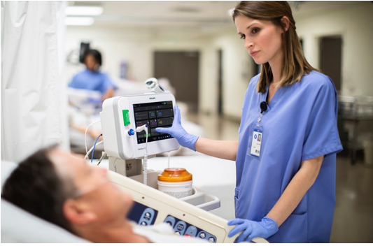
Health Monitoring Device

Slide 2
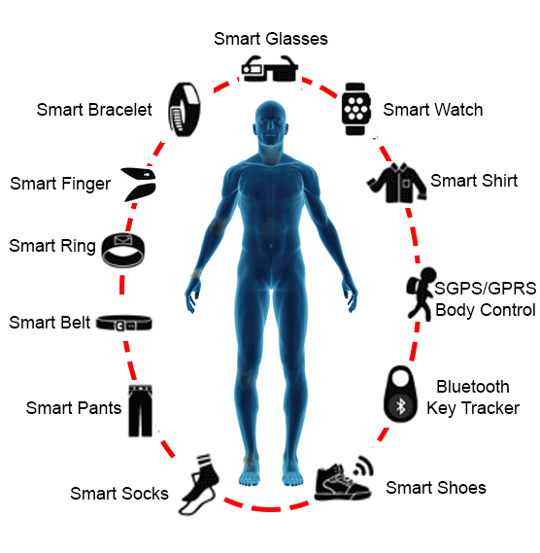
Introduction
Wearables becoming increasingly popular
Easy management of patient records
Quick medical response

Slide 3
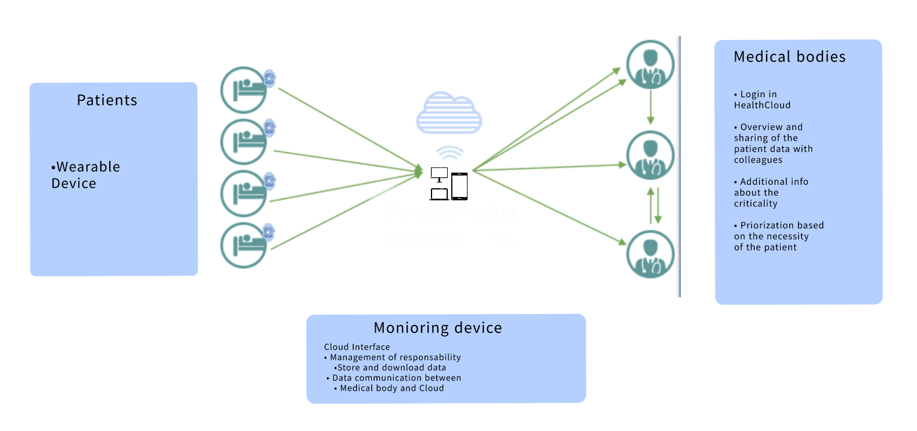

Slide 4
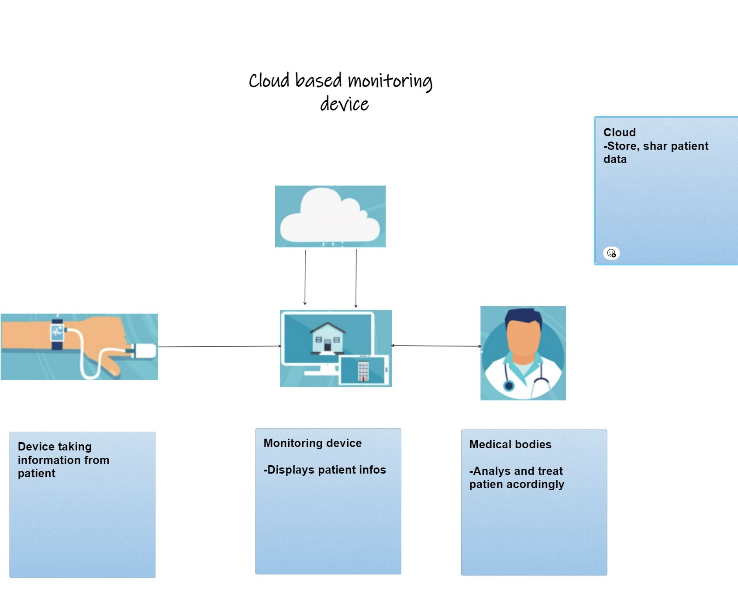

Slide 5
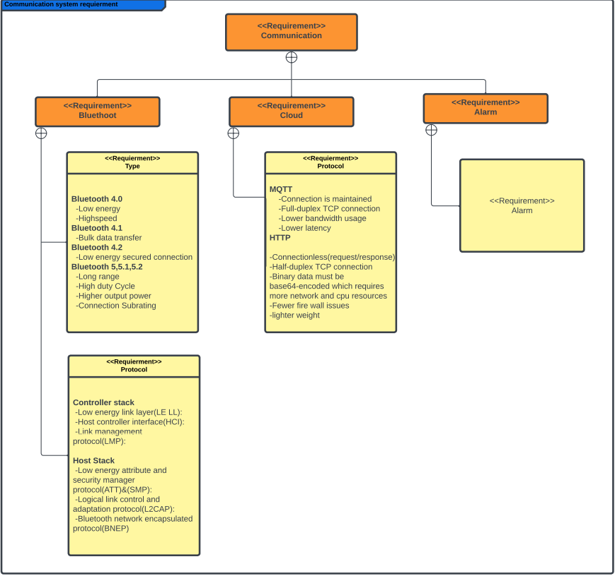


Slide 6
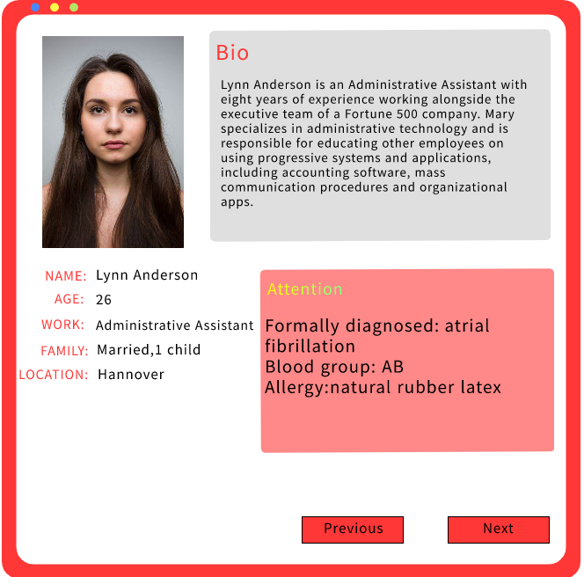
Back
Next

Slide 7
User Interface
A click here takes use to the next screen
Heart beat
Temperature
Blood pressure
Name
Age
More
Back
Next

Slide 8
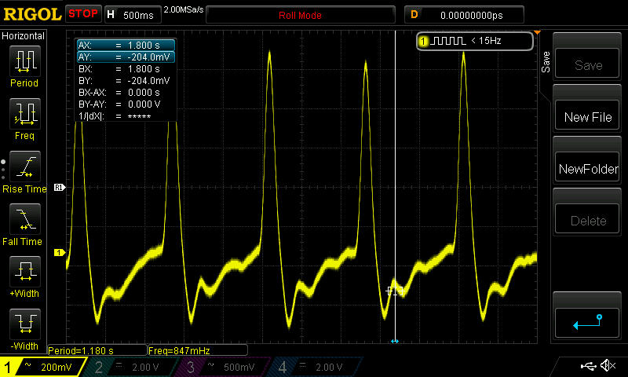
User Interface
Heart beat
Body temperature
Blood pressure
Name
Age
Norms
Peak level: 00
Critical level: 00
More
Back

Slide 9
Recall
Patient
Medical bodied
Monitoring device
Cloud

Slide 10
Technical approach
SENSOR NODE
[Publisher]
MOBILE DEVICE
[SUBSCRIBER/
PUBLISHER]
RASPBERRY PI
[MQTT BROKER]

Slide 11
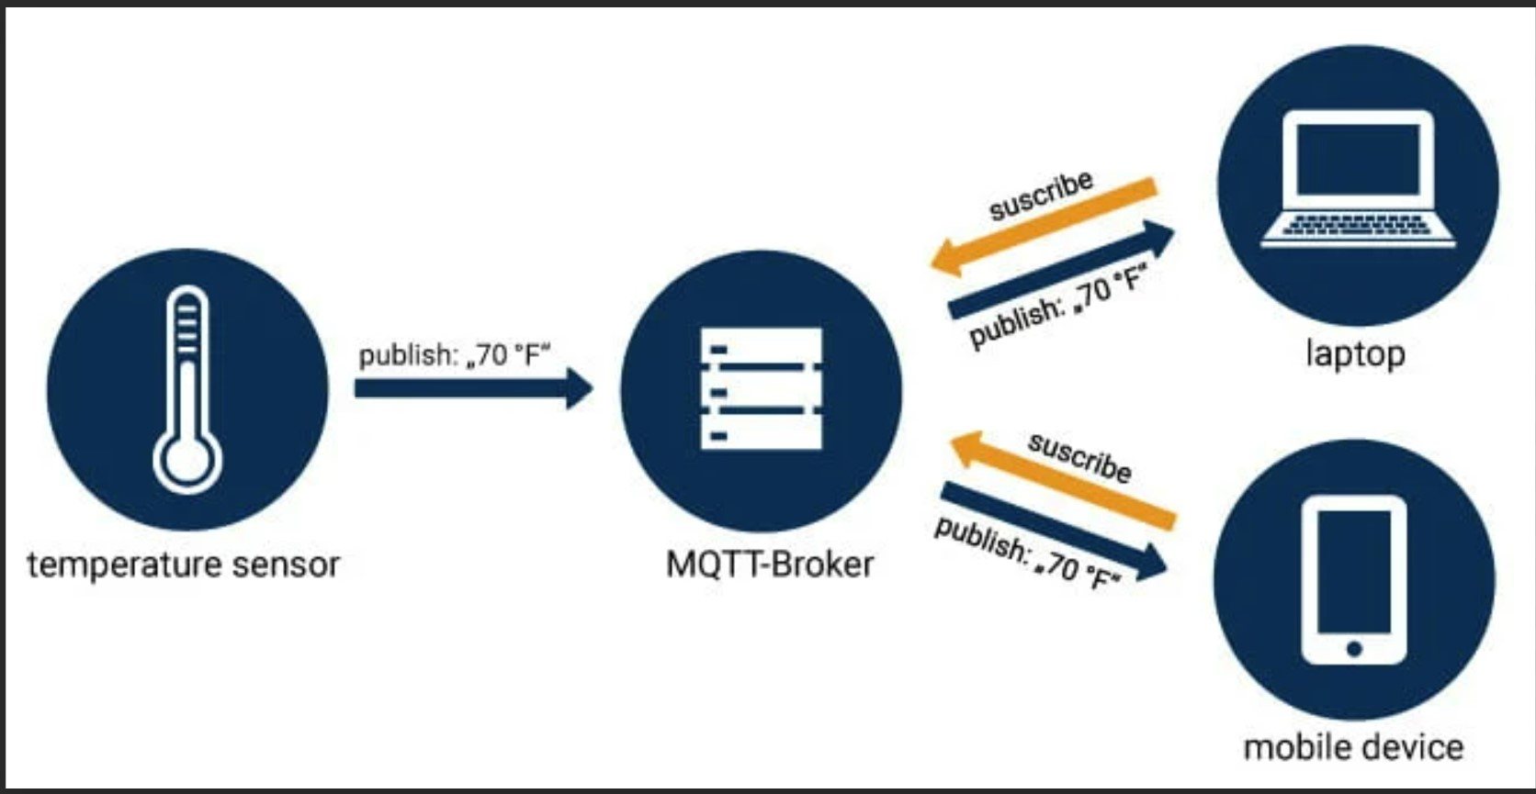
How it works
Heartbeat sensor

Slide 12
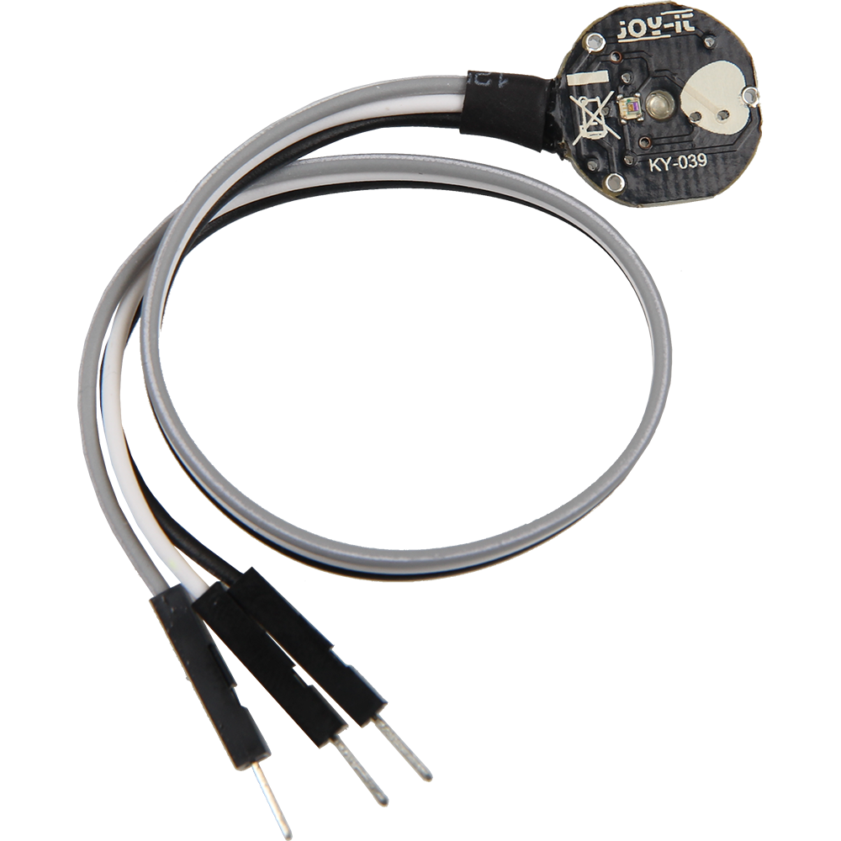
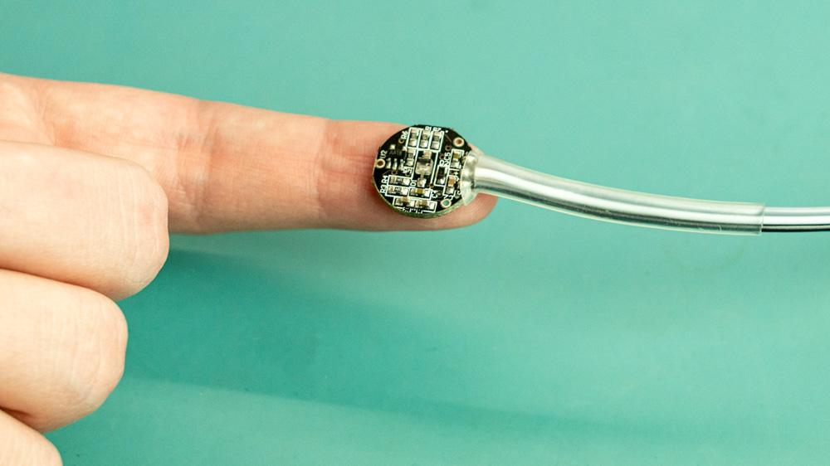
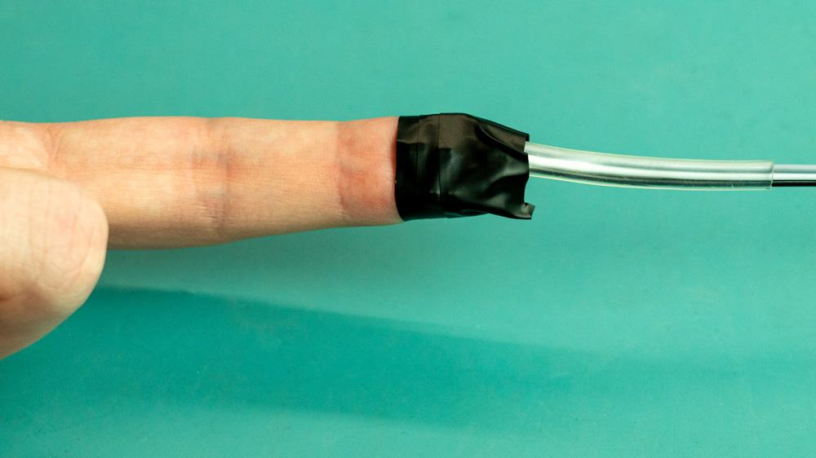
Heartbeat Sensor

Slide 13
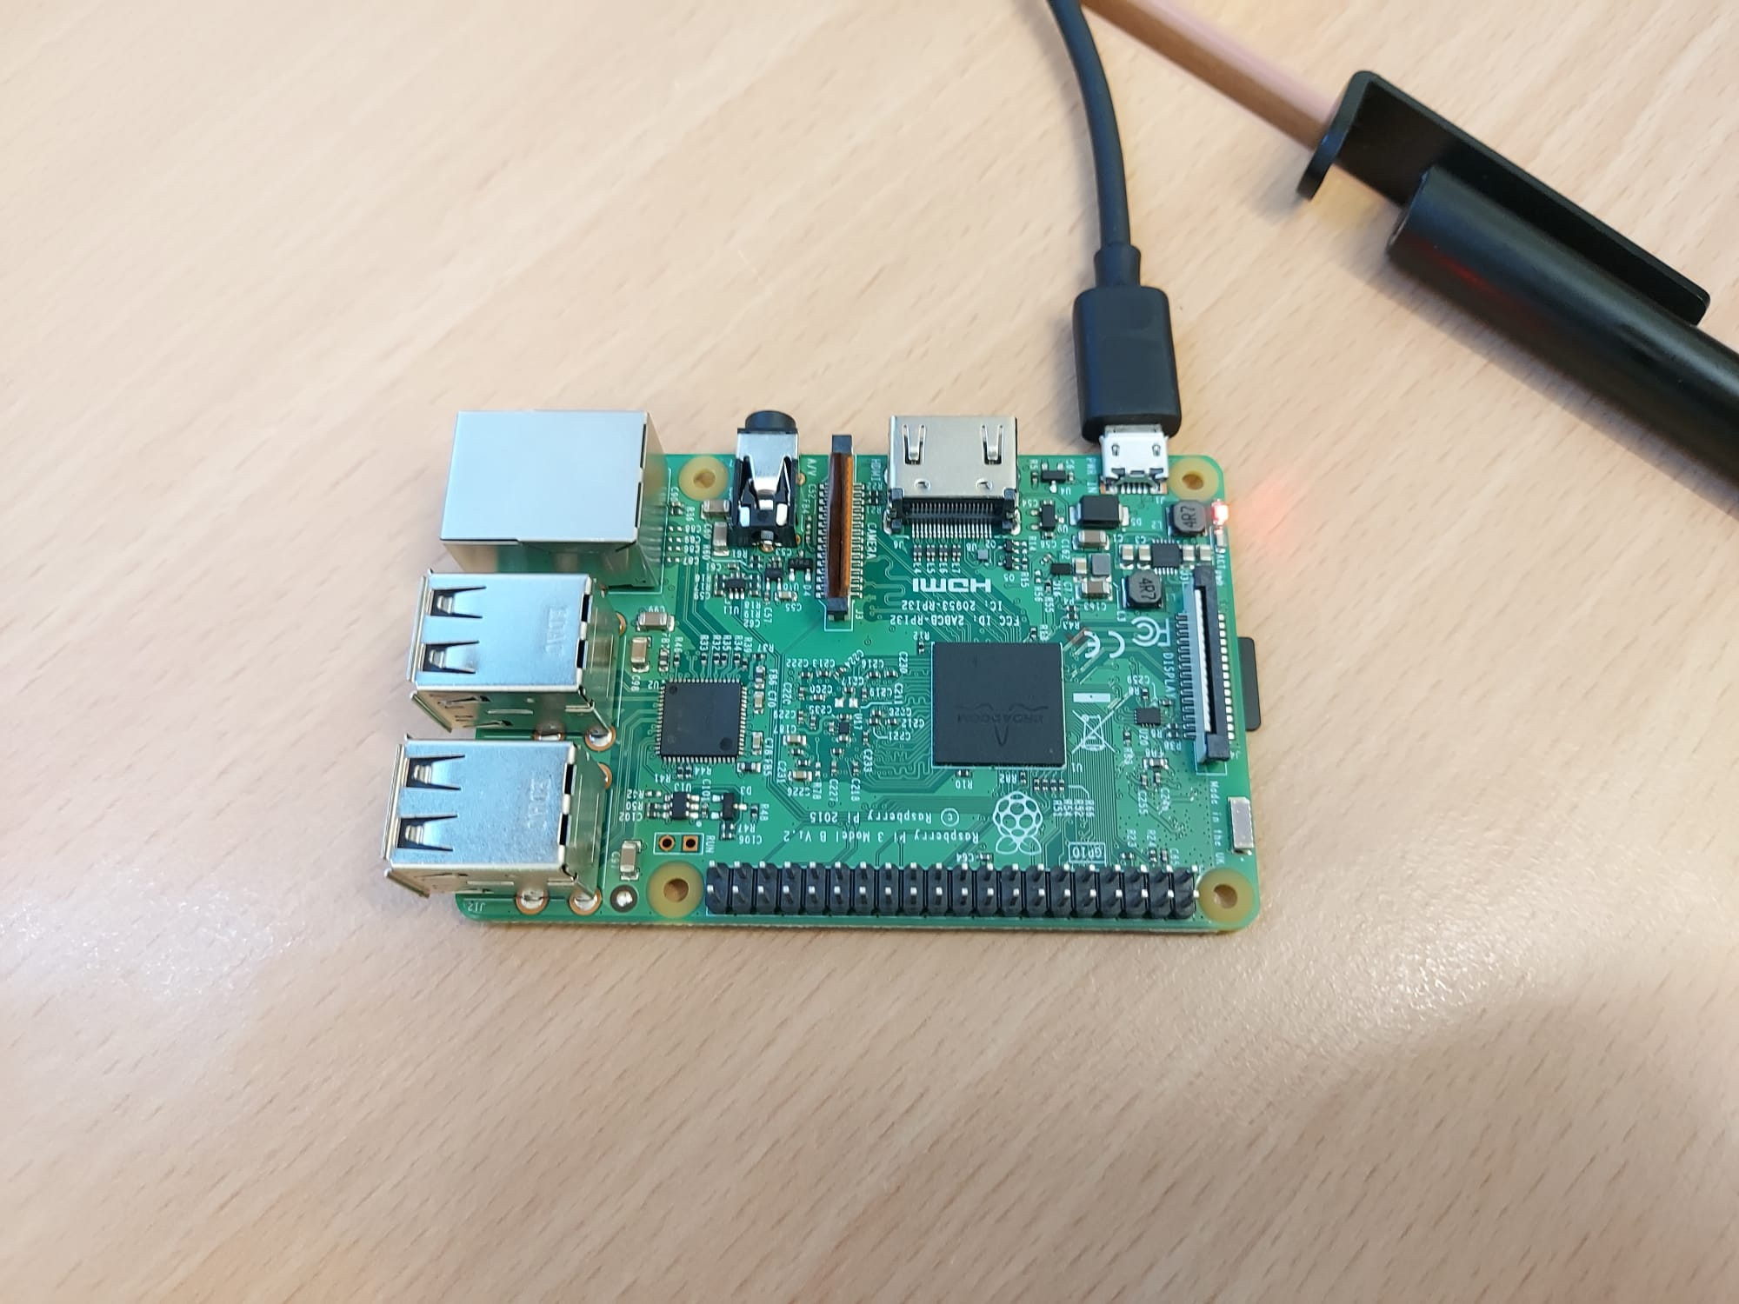
RASPBERRY PI
[MQTT BROKER]

Slide 14
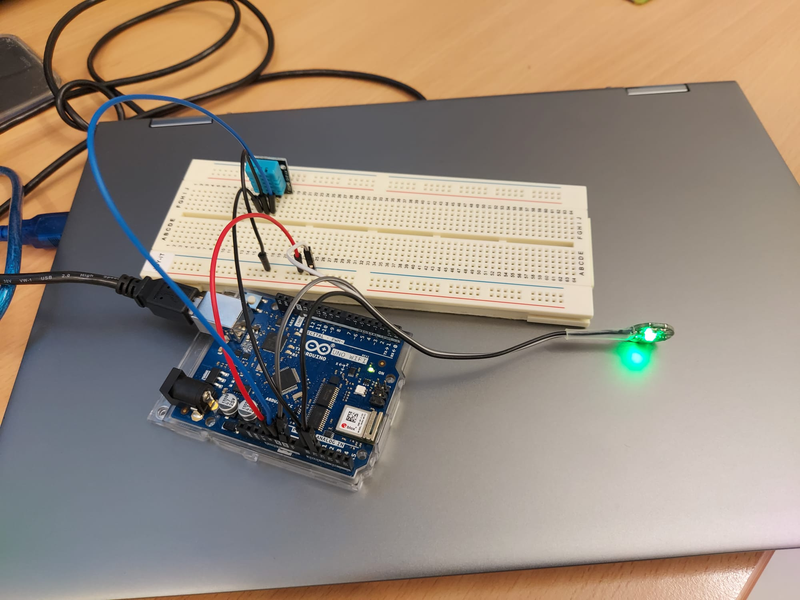
SENSOR NODE
[Publisher]

Slide 15
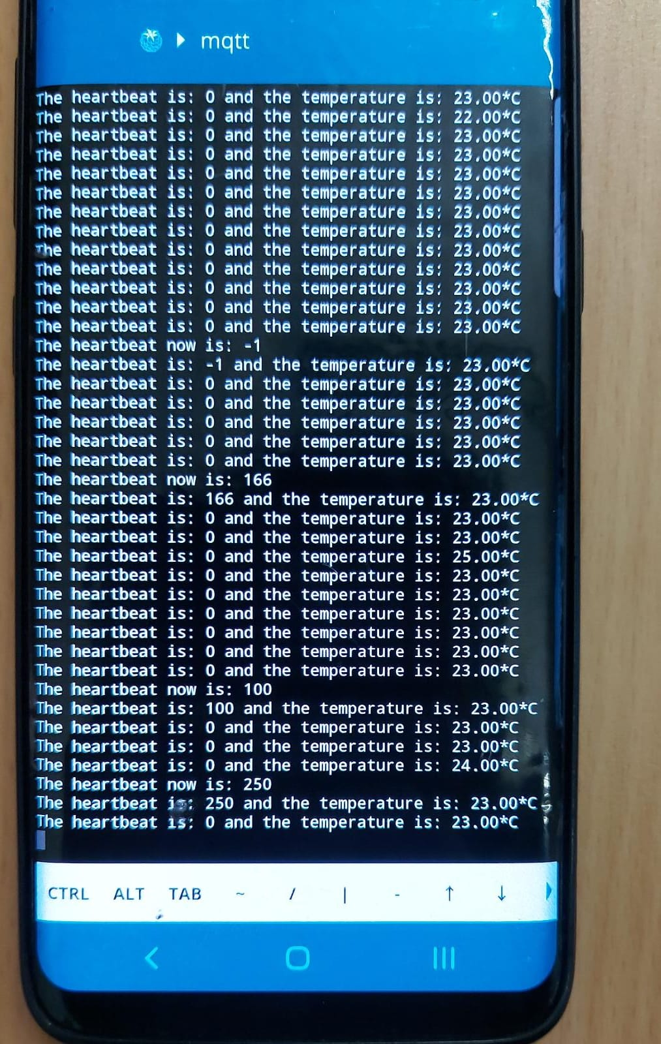
MOBILE DEVICE
[SUBSCRIBER/
PUBLISHER]

Slide 16
Reference images
https://www.researchgate.net/figure/Different-types-of-wearable-technology_fig5_322261039
https://www.designnews.com/sites/designnews.com/files/W6XXNX.jpg
https://www.allheart.com/b-sphygmomanometers.html
https://hbr.org/resources/images/article_assets/2019/05/May19_26_647373390.jpg
https://content.u-blox.com/sites/default/files/Solution-architecture-for-portable-and-wearable-health-devices.jpg
https://sensorkit.joy-it.net/en/sensors/ky-039

